Slide 1

Sauce & Spoon
Tablet Rollout
Impact Report

Slide 2
Executive Summary
Our goal was to launch a pilot project roll out of tabletop menu tablets at two of our restaurant locations, Sauce & Spoon North and Sauce & Spoon Downtown which would allow the restaurant to serve more guests in less time and thus increase profitability and also reduce the food wastage by 25%.
After the launch of the project, we saw a substantial increase of revenue by 10% and 20% each in the respective locations. The guest count also saw an increase by 10% which was a result of the table turn time that was reduced by 30 minutes by the use of tablets. The overall customer satisfaction after the pilot launch was 72% which later increased to 86%.
Below are the few insights gained from the launch,
Training and getting waitstaff to be more aware of guest pacing was an important step to reduce the table time.
A simple layout was adopted which the customers found easy to use and navigate through the tablet.
Clear and concise messages around online payments improved the checkout process.
A new cash register was set up by the kitchen area to speed up cash payments.

Slide 3
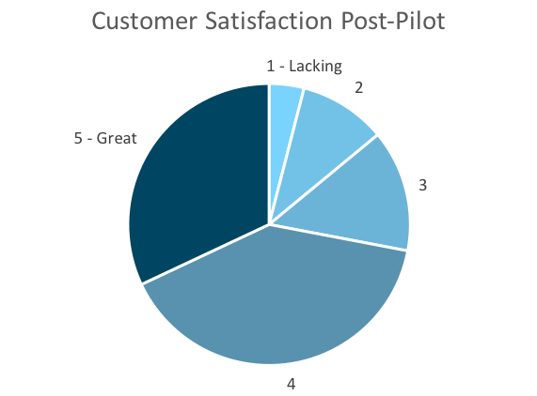
Customer Satisfaction: Pilot
Q. On a scale of 1-5, please rate your experience with the tablet overall.
This pie chart illustrates the results from the post-pilot survey.
72% of respondents indicated a customer satisfaction score of 4 or 5.
Notes:
First pie chart: Results from the post-pilot survey
Second pie chart: Results from the post-launch survey, after making changes
Satisfaction has gone up from 72% (4 and 5 rating) to 86% (4 and 5 rating)
Post-pilot data:
1 - Lacking 2 4%
2 5 10%
3 7 14%
4 20 40%
5 - Great 16 32%
Post-launch data:
1 - Lacking 1 2%
2 2 4%
3 4 8%
4 22 44%
5 - Great 21 42%

Slide 4
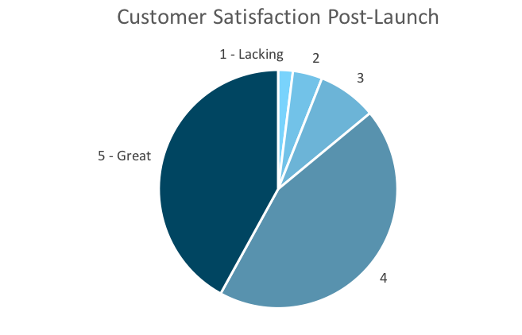
Customer Satisfaction: Launch
Q. On a scale of 1-5, please rate your experience with the tablet overall.
This pie chart illustrates the results from the post-launch survey.
86% of respondents indicated a customer satisfaction score of 4 or 5. This is a 19% increase.
Notes:
First pie chart: Results from the post-pilot survey
Second pie chart: Results from the post-launch survey, after making changes
Satisfaction has gone up from 72% (4 and 5 rating) to 86% (4 and 5 rating)
Post-pilot data:
1 - Lacking 2 4%
2 5 10%
3 7 14%
4 20 40%
5 - Great 16 32%
Post-launch data:
1 - Lacking 1 2%
2 2 4%
3 4 8%
4 22 44%
5 - Great 21 42%

Slide 5
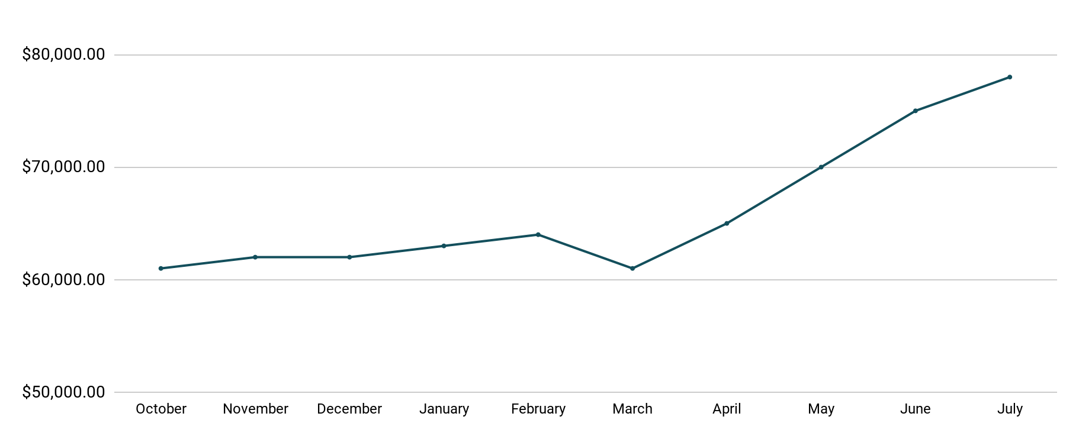
Revenue
Tablet Launch April 23
This is a chart of Sauce & Spoon revenue, showing that after tablet implementation, revenue increased.
July revenue was up to 20% over April’s monthly revenue.
Notes:
This is a chart of Sauce & Spoon revenue, showing that after tablet implementation, revenue increased. December revenue was up to 20% over September’s monthly revenue.
Sales data:
October
$61,000.00
November
$62,000.00
December
$62,000.00
January
$63,000.00
February
$64,000.00
March
$61,000.00
April
$65,000.00
May
$70,000.00
June
$75,000.00
July
$78,000.00

Slide 6
What Worked: Key Accomplishments
Decreased table turn time
Implementation of the tablets increased the average daily guest count by 10%.
Tablets also decreased wait time by 30 minutes.
Decreased food waste
Tablets identified who was receiving an incorrect order.
Kitchen staff has taken the initiative to correct orders and decrease food waste by 50%.
Increased customer satisfaction
After the pilot, customer satisfaction was at 72%.
Once we implemented improvements based on feedback, customer satisfaction increased to 86%.
Increased sales
Our monthly revenue has increased steadily since the tablet rollout, upwards of 20% since September/pre-rollout.
Tablets also helped boost revenue during the holiday season.

Slide 7
Next Steps: Looking Forward
Initiative | Action | Date
Implement tablets in more locations | Create new project plan for new location installation | Q2
Continue to track customer experience and satisfaction | Continue surveying/ gathering data through various means | Ongoing
Expand tablet features | Investigate new features like social media integration, reservations, videos, etc. | Q4

